Slide 1
LOCAL BUSINESS DATA ANALYSIS
GROUP B

Slide 2
Team Members
HEMAMALINI MADHANGURU
MAHSA TAYER FARAHANI
RUCHI SINGH
YASHASWI ANANTH

Slide 3
TABLE OF CONTENTS
Introduction
Project Workflow
Data Specifications
Project Specifications
Data
Visualization
Sentiment Analysis
Geospatial Representation
Insights
Github
References

Slide 4
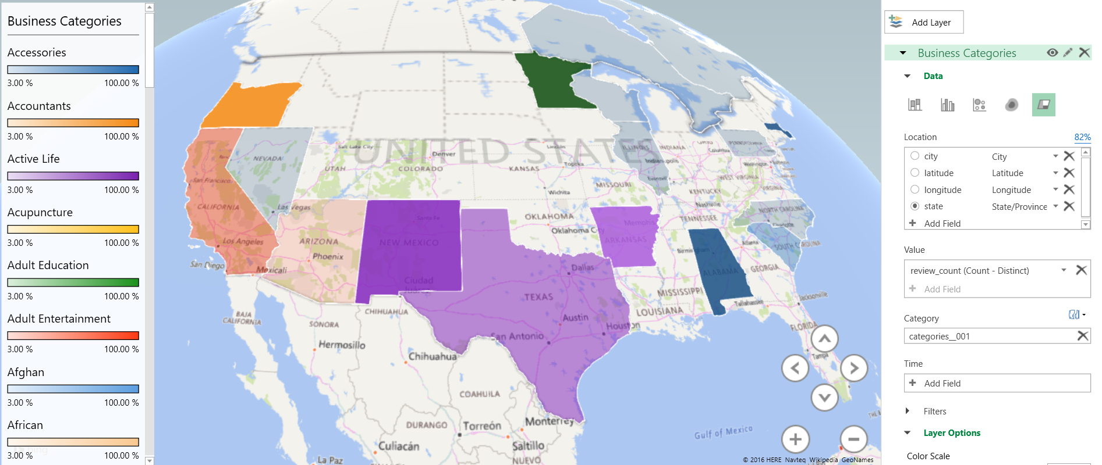
INTRODUCTION
Wide variety of information available about local business
Helps in understanding the performance of the Local Business
Derive insights from the customer reviews for the Local Business
Factors Responsible for the popularity of Local Business

Slide 5
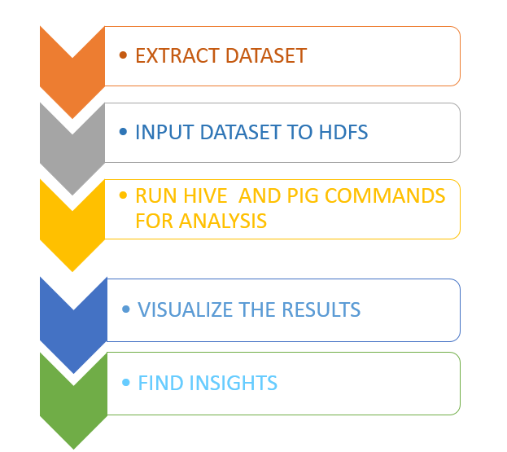
Project workFLOW

Slide 6
DATA SPECIFICATIONS
DATA SOURCE | FILE SIZE | FILE TYPE | Rows | Columns
https://s3.amazonaws.com/hipicdatasets/yelp_raw_fall_2016.csv | 90MB | CSV | 334,335 | 108
https://docs.google.com/uc?id=0B9kspRX6SWaaMlRvREQ3NmUxOE0&export=download | 85MB | JSON | 117,486 | 10
Data Engineering
Removed Junk Data and Duplicate rows
Removed NULL values
Formatted JASON file and converted to CSV
Formatted the data for date time columns

Slide 7
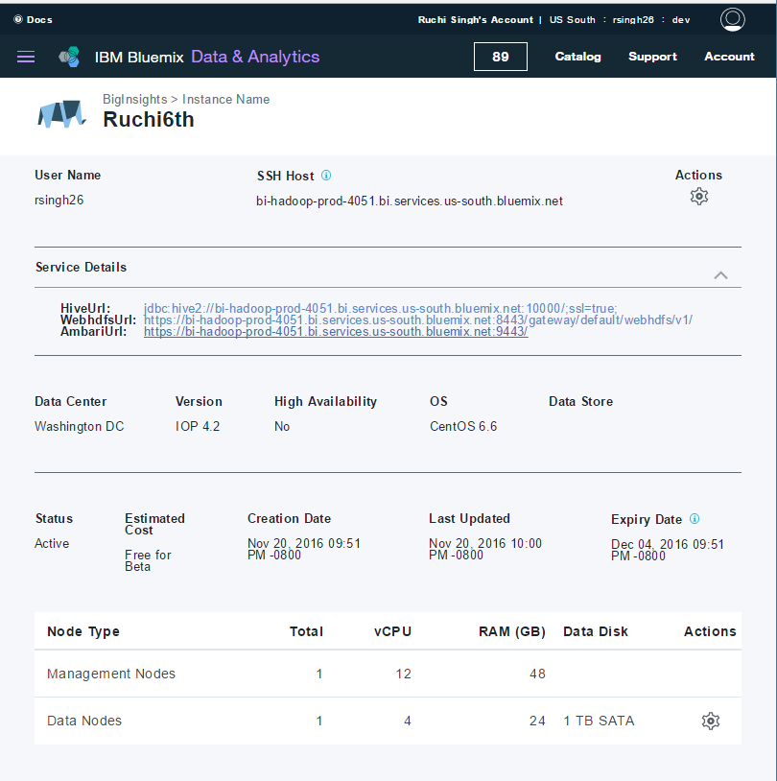
PROJECT SPECIFICATIONS
Cluster on BigInsight
Hive QL and Pig for query
Tableau for visualization
Excel 3D Maps for Geospatial representation
Azure for backup

Slide 8
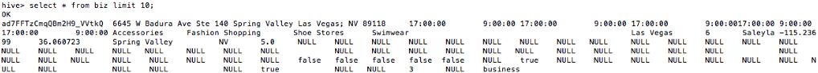
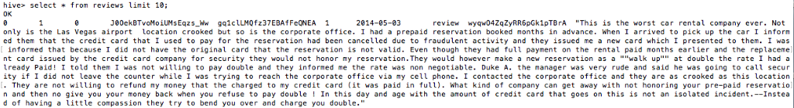
DATA
Local Business Table
Reviews Table

Slide 9
visualizations

Slide 10
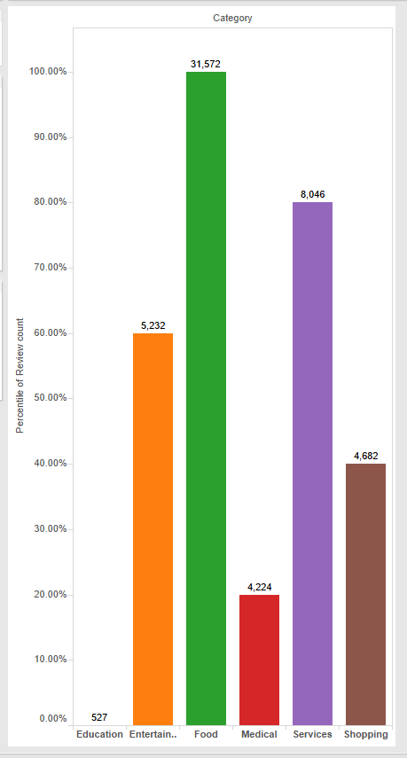
REVIEW COUNT FOR BUSINESS TYPES

Slide 11
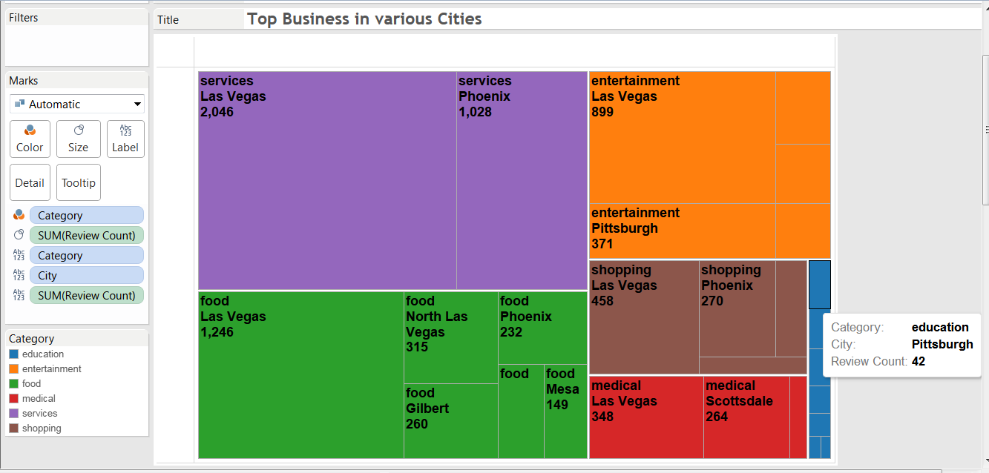
TOP BUSINESS IN THE SIX CATEGORIES

Slide 12
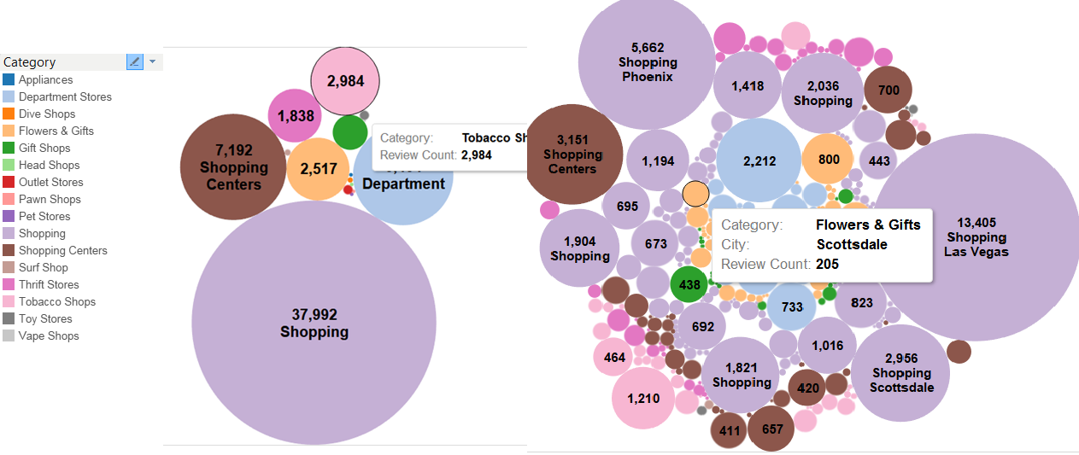
Review count of popular sub-categories of business

Slide 13
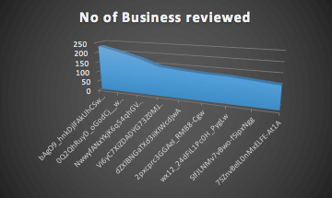
Maximum reviews
Maximum number of reviews made by unique user IDs over 10 years
Further text analysis of the reviews is required to investigate the authenticity of these reviews

Slide 14
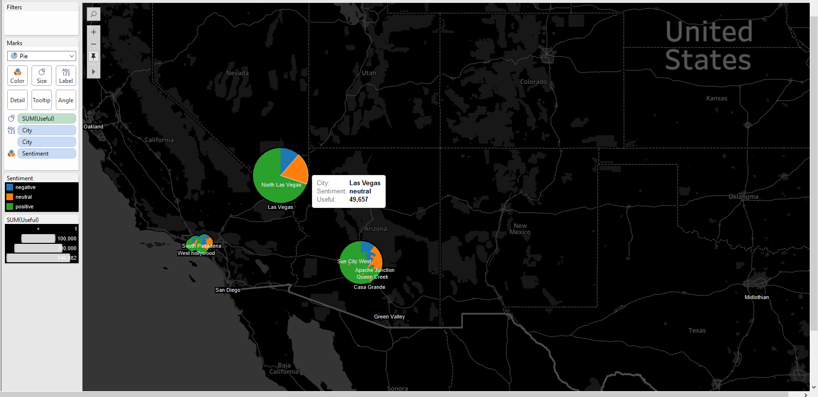
SENTIMENT ANALYSIS

Slide 15
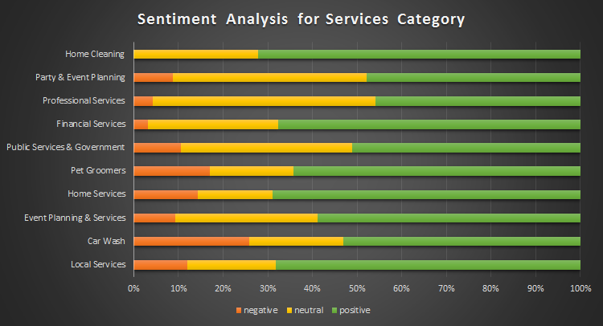
Sentiment Analysis of Services category

Slide 16
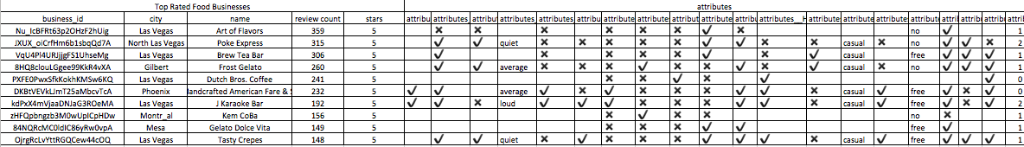
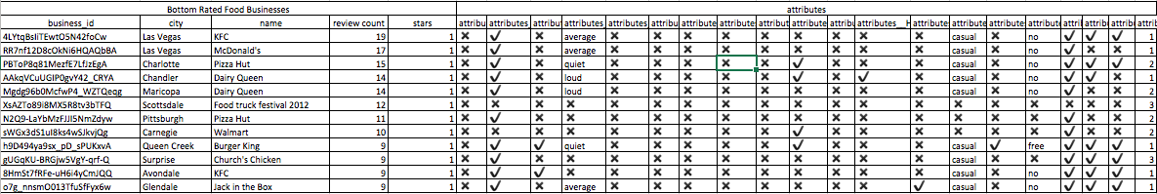
Popular and unpopular food business attributes

Slide 17
Comparison of the key attributes
reservation |  | ambience |  | wheelchair |  | has tv |  | wifi
top | bottom | top | bottom | top | bottom | top | bottom | top | bottom
✖️ | ✖️ | ✔️ | ✖️ | ✔️ | ✖️ | ✔️ | ✖️ | free | no
✔️ | ✖️ | ✖️ | ✔️ | ✔️ | ✖️ | ✖️ | ✖️ | free | no
✔️ | ✖️ | ✔️ | ✖️ | ✖️ | ✖️ | ✖️ | ✖️ | free | no
✖️ | ✖️ | ✖️ | ✖️ | ✔️ | ✖️ | ✖️ | ✖️ | no | no
✔️ | ✖️ | ✔️ | ✖️ | ✖️ | ✖️ | ✔️ | ✔️ | free | no
✔️ | ✖️ | ✖️ | ✔️ | ✔️ | ✖️ | ✔️ | ✖️ | free | no
✔️ | ✔️ | ✔️ | ✔️ | ✔️ | ✖️ | ✔️ | ✖️ | free | free
✔️ | ✖️ | ✔️ | ✖️ | ✔️ | ✔️ | ✔️ | ✔️ | no | free
✔️ | ✔️ | ✔️ | ✔️ | ✖️ | ✖️ | ✔️ | ✔️ | free | no
✔️ | ✖️ | ✔️ | ✖️ | ✔️ | ✖️ | ✖️ | ✖️ | free | free
80% | 20% | 70% | 40% | 70% | 10% | 60% | 30% | 80% | 30%

Slide 18
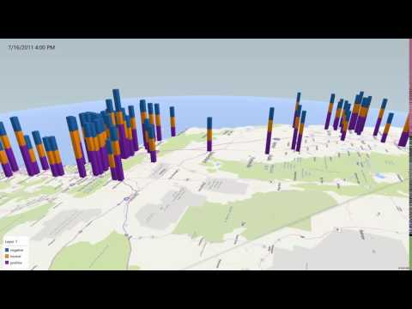
GEOSPATIAL REPRESENTATION

Slide 19
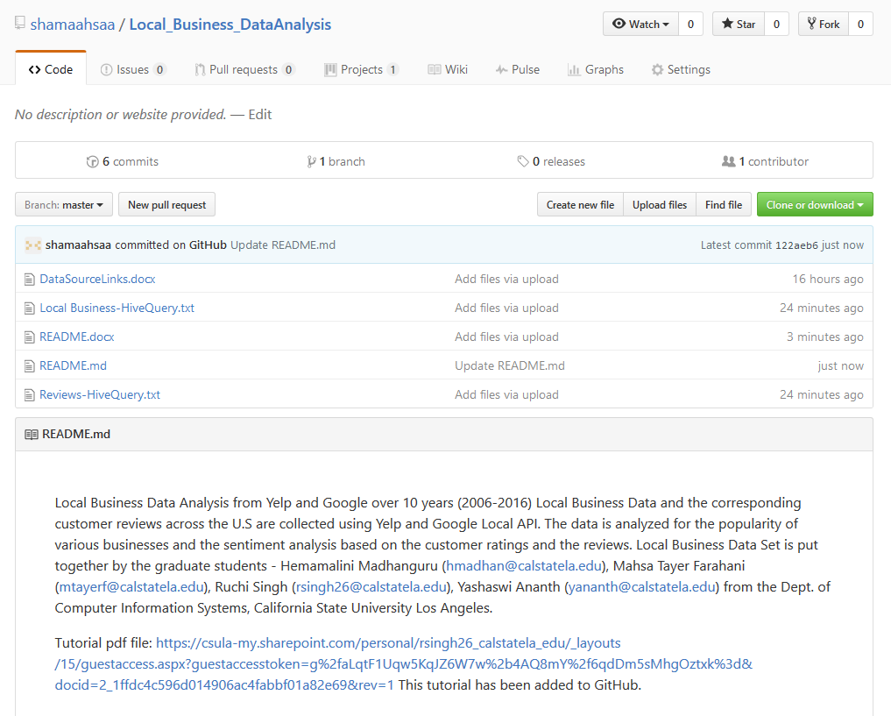
GITHUB
https://github.com/shamaahsaa/Local_Business_DataAnalysis

Slide 20
INSIGHTS

Slide 21
insights
Food is the most popular category of Local Business based on the reviews
Las Vegas is the most popular city based on review count for Local Business in every category
Reservation, Ambience, Wifi are some of the main factors responsible for the popularity of food business
More than 60% of people in a city write positive reviews for Local Business
Around 250 reviews(maximum) were written by one reviewer in a span of 10 years

Slide 22
REFERENCES
http://www.tableau.com
https://hortonworks.com/tutorials
Prof. Woo's Big Data Resource: instructional1.calstatela.edu/jwoo5/classes/2016/fall/cis5200/

Slide 23
THANK YOU Questions...

